Slide 1
Secure the Quality of OS in Spacecraft

Slide 2
Class Operation
Lecturer: Professor Daeryong Lee
Class Operation:
- Class Time & Room : 16:00~19:00(3 Hrs.) Tue, S2-402
- Operation : Lecture(50%), Student Presentation(15%), Practice/Project(35%)
- Student: AI. Big Data Department (2nd year and above)
Evaluation (A 30%, B 40%, C and Under 30%), 3 Credits
- Attendance: 20%
- Assignment: 10%
- Attitude(Tardiness Check): 5%
- Mid-term Exam: 25%
- Project Task: 40%
    Project Proposal Presentation(10%) – per team
    Project Completion Presentation(20%) – per team
    Individual Contribution and Peer Evaluation(10%) – per student
  Contact : lldr12@wsu.ac.kr, lldr12@naver.com , 010-9530-4784
  Office - S2 6th Fl. #106

Slide 3
Class Schedule
Week | Date | Contents
Week 1 | 9/1 | 1. Introduction to Operating Systems
Week 2 | 9/8 | 2. Hardware and Software Concepts
Week 3 | 9/15 | 3. Process Concepts
Week 4 | 9/22 | 4. Thread Concepts
Week 5 | 9/29 | 5. Asynchronous Concurrent Execution
Week 6 | 10/6 | 6. Concurrent Programming 7. Deadlock and Indefinite Postponement
Week 7 | 10/13 | 8. Processor Scheduling 9. Real Memory Organization and Management
Week 8 | 10/20 | 10. Virtual Memory Organization 11. Virtual Memory Management
Week 9 | 10/27 | Mid-Term Exam PBL Class Introduction
Week 10 | 11/3 | Research the Project Make Project Proposal
Week 11 | 11/10 | Present Project Proposal
Week 12 | 11/17 | Project Development
Week 13 | 11/24 | Present Project Progress & Status
Week 14 | 12/1 | Project Development
Week 15 | 12/8 | Project Completion Presentation
Theory Class
PBL Class

Slide 4

Why PBL? (1/3)
Skills of Engineers Desired by U.S. Employers
[2015]
Order | Quality/Skill | Importance (5=Very Important) | Soft/Hard
1 | Communication Skills(대화 능력) | 4.8 | Soft Skills
2 | Honesty/Integrity(정직/성실) | 4.7
3 | Interpersonal skills(대인관계) | 4.5
4 | Motivation/Initiative(동기/주도적) | 4.5
5 | Strong Work Ethic(윤리) | 4.5
6 | Teamwork Skills(팀워크) | 4.5
7 | Analytical Skills(분석능력) | 4.4 | Hard Skills
…. | …. | ….
18 | GPA(3.0 or Better)(학점) | 3.6

Slide 5
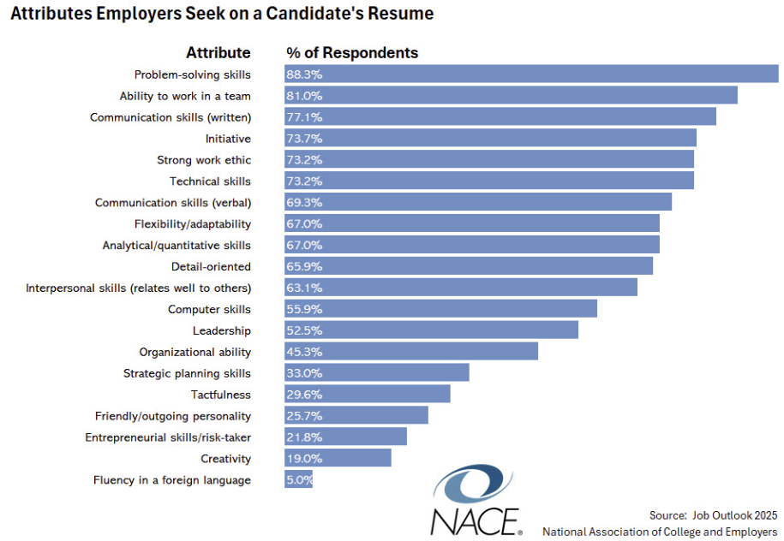
Why PBL? (2/3) - Skills required by companies
[2025]

Slide 6
The Six Modern Traits of “Googliness” (Sundar Pichai, 2024)
Mission First
  Focus on Google’s broader purpose — building things that make the world’s information useful and accessible.
  Think beyond personal or team goals and align with the company’s long-term mission.
Make Helpful Things
  Create technology that genuinely helps users, not just demonstrates technical prowess.
  Every project should aim to solve real human problems.
Be Bold and Responsible
  Take smart risks, experiment, and innovate — but with accountability for consequences.
  “Boldness without care isn’t courage; it’s recklessness.”
Stay Scrappy
  Work resourcefully even with limited means.
  Google wants people who can move fast, adapt quickly, and still deliver quality.
Hustle and Have Fun
  Bring energy and passion to work while maintaining balance and joy in collaboration.
  Success should include a spirit of play and curiosity.
Team Google
  Think and act as part of a collective.
  Prioritize collaboration, humility, and empathy over individual achievement.

Slide 7
What is PBL? =“Project Based Learning”
What can we experience through PBL?
Self-Introspection
Raising many Questions
Self-Problem Analysis
Completion
Of Solution
Improve Presentation
Skill
Do Self and Peer Evaluation
Make
Learning
Plan
Self-directed Learning

Slide 8
Project - Secure the Quality of OS in Spacecraft (1/3)
Background and Problem Scenario
  To expand its business, Amazon recently developed FreeRTOS, a real-time operating system that can be used in electronic devices and equipment. Elon Musk decided to use it in Space-X's manned spacecraft. However, as FreeRTOS was developed too urgently, they found there is an issue with the function of Task Management. To address this problem, Amazon asked students studying the operating system at Woosong University to implement one of 4 tasks in order to verify FreeRTOS’s whole functionalities. Students should team up to implement the task to check if there are any problems related to FreeRTOS.

Slide 9
Project - Secure the Quality of OS in Spacecraft (3/3)
Project Deliverables
  Project Proposal Presentation File
  Project Completion Presentation File
  Individual Contribution and Peer Evaluation File
  GitHub Link that has Program Files
    Must use GitHub.
  Cooperation History Link
    Must use Notion.
Evaluation (40 Points)
  Project Proposal Presentation (10 Points) – per team
  Project Completion Presentation (20 Points) – per team
    Will check Github and Notion.
  Individual Contribution and Peer Evaluation(10 Points) – per student

Slide 10
Secure the Quality of OS in Spacecraft (1/2)
Work Schedule
Reference Document and Resources (Refer to LMS)
  Amazon FreeRTOS Site: https://www.freertos.org/
  https://www.freertos.org/Documentation/02-Kernel/07-Books-and-manual/01-RTOS_book includes
    Mastering the FreeRTOS Real Time Kernel - A Hands-On Tutorial Guide
    Book Companion Source Code (source-code-for-book-examples.zip)
    FreeRTOS_Reference_Manual
 | Milestones | Learning Activity | Week
1 | Research Project | Select One Task Among 4 Project Tasks Research Project Task Make Project Proposal Presentation | Week 9 (10/27)
2 | Project Proposal Presentation | Present Project Proposal | Week 11 (11/10)
3 | Project Progress Presentation | Present the Intermediate Project Progress | Week 13
4 | Project Completion Presentation | Presentation and Demonstration | Week 15

Slide 11
Project Task 1 (1/4)
Task 1 - Spacecraft Communication System
  In the process of applying FreeRTOS-based systems to Spacecraft that require high reliability, Amazon recognized the need to analyze the behavior characteristics in actual system scenarios beyond the individual behavior verification of the FreeRTOS API. In particular, in environments where various types of messages are generated at the same time, such as communication systems inside spacecraft, and the importance of messages and the timing of processing are directly related to system safety, it is necessary to comprehensively verify the impact of task scheduling and inter-task communication mechanisms on the overall operation of the system. Therefore, Amazon has conducted a comprehensive survey of students who have completed the basic task verification of the operating system. An application scenario assuming a FreeRTOS-based spacecraft internal communication system was presented. In this scenario, students need to design a structure that can reliably handle communication data of different importance, such as general messages, urgent messages, and system messages, in a multi-task environment. In this application task, students will design and implement task separation according to message type, priority-based scheduling, communication between tasks using queues, retries, and logging mechanisms, thereby verifying whether FreeRTOS-based systems can operate reliably in real-world high-reliability communication scenarios.

Slide 12
Project Task 1 (2/4)
Objectives of the task
    Design message processing flows in a FreeRTOS-based multi-task environment
    Analyze the impact of task priorities and scheduling on system behavior
    Validating the Stability of Queue-Based Message Delivery Mechanisms
    Implement real-time system characteristics such as retries and logging
    Experience connecting between operating system theory and real-world RTOS behavior

Slide 13
Project Task 1 (3/4)
Design and Implement the Following Features(1/2):
  Separate message types
    Normal Message
    Emergency Message
    System Message and etc.
    Each message is designed to have a different processing priority.
  Task-based message processing structure
    Sender Tasks
    Receiver Tasks
    Logger Tasks
    Message Retry Management Tasks and etc.
    Each task is created and managed using the FreeRTOS Task Management API.

Slide 14
Project Task 1 (4/4)
Design and Implement the Following Features(2/2):
  Queue-based communication mechanism
    Messages are passed between tasks via Queue
    Observe queue length, message backlog
  Retry and backoff logic
    Perform a retry on a failed message delivery
    Apply backoff as the number of retries increases
  Simple encryption and log history
    Simulate data protection in transit with XOR-based encryption
    Timestamp-based structured log output

Slide 15
Project Task 2 (1/4)
Task 2 - Spacecraft Orbital Mission Communication System
  In the process of applying FreeRTOS-based systems to high-trust environments with clearly defined mission phases, such as aerospace, Amazon recognized that further validation was needed to ensure that task management and scheduling mechanisms could reliably support system requirements that changed over time. The mission of the spacecraft system is divided into launch phase, ascent stage, and orbit entry stage from launch to altitude gain to entry into the target satellite orbit, and each stage greatly varies in the importance, processing cycle, and real-time requirements of communication data exchanged with the ground. In such an environment, the operating system must function as a key control element that keeps the system stable as the mission phase changes, beyond simply executing multiple tasks in parallel. Therefore, Amazon presented an RTOS-based communication system application scenario assuming the mission flow from launch of the spacecraft to orbit for students who have completed the basic task verification of the operating system. In this scenario, students need to analyze the changing communication requirements at each mission stage, adjust task priorities, change execution cycles, and design a structure that can maintain communication stability even in a multi-task environment by adjusting task priorities, changing execution cycles, and designing message processing structures. In this application task, students will analyze the impact of mission phase changes on task scheduling and message processing, and verify whether FreeRTOS-based systems can operate reliably in a high-reliability mission environment

Slide 16
Project Task 2 (2/4)
Objectives of the task
    Analyzing system requirements as mission phases change
    Design of phased communication message characteristics (frequency, importance, delay tolerance)
    Design and align task priorities and execution cycles
    Implement a reliable message processing structure in a multi-task environment
    Develop thinking skills to interpret mission-based systems from an operating system perspective

Slide 17
Project Task 2 (3/4)
Design and Implement the Following Components(1/2):
  Defining mission phases
    Launch Phase, Ascent Phase, Orbit Insertion Phase
  Designing a step-by-step communication message
    Launch Ascendant Phase: High-frequency, high-priority status and telemetry messages
    After Orbit: Status Monitoring Messages and Ground Command Incoming Messages
    Pre-mission Section: Emergency messages that are processed immediately in case of an emergency
  Designing the task structure
    Telemetry Processing Task
    Command Reception Task
    Emergency Handling Task
    Logging / Monitoring Task and etc.
    Each task is designed to have a different priority or execution cycle depending on the mission stage.

Slide 18
Project Task 2 (4/4)
Design and Implement the Following Components(2/2):
  Queue-based communication structure
    Transfer data between tasks using message queues
    Observe queue backlogs and processing delays
    Analyze changes in system behavior when transitioning mission phases
  Behavioral analysis and limit assessment
    Analyze delays and crashes when switching steps
    Analyze the effectiveness of task prioritization
    Presenting design limits and potential improvements

Slide 19
Project Task 3 (1/4)
Task 3 - Mars Rover Exploration System
  In the process of applying the FreeRTOS-based system to a complex embedded system with multiple functional modules operating in parallel, such as movement control, sensor data collection, communication, power management, and self-monitoring, Amazon recognized that the design of tasks at the operating system level and resource management had a decisive impact on system stability rather than the implementation of individual functions. In particular, systems such as the Mars Rover run multiple functional tasks simultaneously and use shared resources competitively, so systematic verification of interactions between tasks, resource sharing methods, prioritization, and the likelihood of deadlocks is essential. These problems cannot be revealed by a single functional test alone, but can only be confirmed by designing and analyzing the entire system structure from the perspective of the operating system. Accordingly, Amazon presented a multi-function integration scenario assuming a Mars exploration rover system for students who have completed the basic task verification of the operating system. In this scenario, students should design movement, sensors, communication, power management, and self-monitoring functions as independent tasks, and construct a structure to manage these tasks in an integrated FreeRTOS environment. In this application task, students analyze the conflicts, delays, and resource competition problems that arise as the number of system functions increases, and directly experience and explain the limitations and design trade-offs that the operating system concept reveals in a complex real-world system

Slide 20
Project Task 3 (2/4)
Objectives of the task
    Designing a task structure in a system with multi-function modules
    Analyze the reliability of inter-task communication and synchronization mechanisms
    Observe problem situations that occur when system load increases
    Understanding deadlocks, delays, and the potential for priority reversal
    Cultivate thinking skills to control system complexity from the perspective of operating system design

Slide 21
Project Task 3 (3/4)
Design and Implement the Following Components(1/2):
  Define key functional modules
    Driver / Motor: Movement Control and Obstacle Avoidance
    Sensor: Collection of exploration data such as temperature and topography
    Communication: Report status and receive commands
    Navigation: Route history and map creation
    Power: Manage power consumption by task
    Self-Monitor: Detect module errors and attempt to repair them
    Main Computer: Full Task Control and Distribution
  Task-based system architecture design
    Organize each module into independent tasks
    Define the cross-task message delivery and synchronization structure
    Set priorities and execution cycle

Slide 22
Project Task 3 (4/4)
Design and Implement the Following Components(2/2):
  System integration and execution
    Multi-task execution in a FreeRTOS environment
    Observe behavior based on interaction between modules
    Monitoring Condition with Visualizers
  Analyzing the problem situation
    Increased complexity due to strong coupling between tasks
    Observing deadlocks and system freezes
    Analyze stack size setting errors and priority issues
  Design modifications and limitations assessment
    Simplify architecture and reduce functionality
    Analysis of the trade-offs between Realism and Achievability
    Summary of unimplemented features and improvement directions

Slide 23
Project Task 4 (1/4)
Task 4 - Spacecraft On-board System Monitoring System
  In applying FreeRTOS-based systems to spacecraft internal systems that require high reliability, Amazon recognized the need to reconsider the role of operating systems in environments where various system states such as CPU load, memory usage, battery status, sensor abnormalities, and radiation levels need to be monitored simultaneously. Many of these status information do not require immediate processing in normal times, but when a certain critical condition is reached, a delay-free response is directly related to system safety. In such an environment, a state-based dynamic task management strategy that creates or stops tasks and dynamically adjusts priorities as the system state changes is essential, rather than a static task structure that always executes all functions. However, this strategy can lead to increased system load or unexpected instability if task management policies are inadequate. Therefore, Amazon presented a dynamic task management application scenario assuming monitoring of the internal system of the spacecraft for students who have completed the basic task verification of the operating system. In this scenario, students should leverage FreeRTOS' task management capabilities to design an operating system structure that "always watches, but only actively intervenes when necessary." In this application task, students will design and implement mechanisms for creating and terminating condition-based tasks, adjusting priorities, and monitoring system health, thereby analyzing and explaining how operating systems can ensure both stability and efficiency in systems with complex internal states.

Slide 24
Project Task 4 (2/4)
Objectives of the task
    Design and Implement System Health Monitoring Tasks
    Understanding the Condition-Based (Task Trigger) Dynamic Task Creation and Termination Structure
    Correlation analysis between CPU, memory, and battery health and task management
    Experience the need for Watchdog and error recovery mechanisms
    Understanding the role of the operating system from the perspective of "resource manager + safety manager"

Slide 25
Project Task 4 (3/4)
Design and Implement the Following Components(1/2):
  Always-on Tasks (Core Monitoring Tasks)
    CPU utilization monitoring task
    Heap/Stack Usage Monitoring Tasks
    Basic sensor health check tasks
  Conditional Dynamic Tasks
    Low Memory Situation Response Tasks
    Task on responding to excessively high temperature and radiation thresholds
    Battery Low Voltage Response Tasks
    Communication delay or unresponsive detection task

Slide 26
Project Task 4 (4/4)
Design and Implement the Following Components(2/2):
  Task creation and closing policies
    Create a task when a critical condition occurs
    End task or down prioritize when returning to normal
    Consider state history and data retention before task deletion
  Watchdog and Stability
    Task responsiveness monitoring
    Recovery or system protection behavior when an unhealthy task is detected
    System log history
  Simulation-based state change experiments
    Configure battery, temperature, radiation, and load change scenarios
    Observe the task life cycle as conditions change
    System Stability and Limitations Analysis

Slide 27
Team & Team members
# | Team | ID | Name |  | # | Team | ID | Name
1 |  | 202512451 | Shahi Ramita Kumari |  | 19 |  | 202512398 | Omar Arlan
2 |  | 202512406 | Aruunov Adil Iskhakovich |  | 20 |  | 202512422 | Chowdhury Tasnuva Ahmad
3 | 1 | 202412155 | Emu Mst Himel Haider |  | 21 | 4 | 202512467 | Mills Madison
4 |  | 202310628 | 이원석 |  | 22 |  | 202212230 | Farhodova Fariza Farkhodovna
5 |  | 202412139 | Naeem Zibrij |  | 23 |  | 202512485 | Turatbekov Dilnur
6 |  | 202608432 | Sushanth Kunde |  | 24 |  | 202608427 | Sahsah Adam
7 |  | 202512336 | Panaeva Polina |  | 25 |  | 202512413 | Mojumder Diganta
8 |  | 202412372 | Esonov Sunnatbek Saydulla Ugli |  | 26 |  | 202412428 | Fatima Laraib
9 | 2 | 202512310 | Rajbhandari Kusum |  | 27 | 5 | 202512356 | Kharal Pujan
10 |  | 202512450 | Nurmatov Tynchtykbek |  | 28 |  | 202412318 | Ngo Thi Ngoc Mai
11 |  | 202512389 | Khan Muhammad Ahmed Murtaza |  | 29 |  | 202510023 | Alavee Ahmed
12 |  | 202608452 | Singla Vaidant(?) |  | 30 |  | 202608447 | Vashist Pushkal
13 |  | 202512492 | Woudneh Naomi Eskinder
14 |  | 202512390 | Le Huu Duy |  |  |  | 202512428 | Alhama Mhd Feras(?)
15 | 3 | 202412354 | Harneet Kaur |  |  |  | 202210040 | 추경연
16 |  | 202512435 | Yadav Roshan Kumar |  |  |  | 202412409 | Sadi Md Ahsanul Haque
17 |  | 202512538 | Mureithi Alvin Kinyua
18 |  | 202608424 | Denis Mathis Ghislain

Slide 28
Team Member’s R&R
Role & Responsibility
Project Name | ???
Team Name | ???
Team Member | Leader | Name Here
Technical Role & Responsibility |  | Name Here
 | You decide | Name Here
 |  | Name Here
 |  | Name Here
Sub-Role & Responsibility | Co-Leader | Name Here
 | Meeting Note | Name Here
 | Report Writer | Name Here
 | Presentation Maker | Name Here

Slide 29
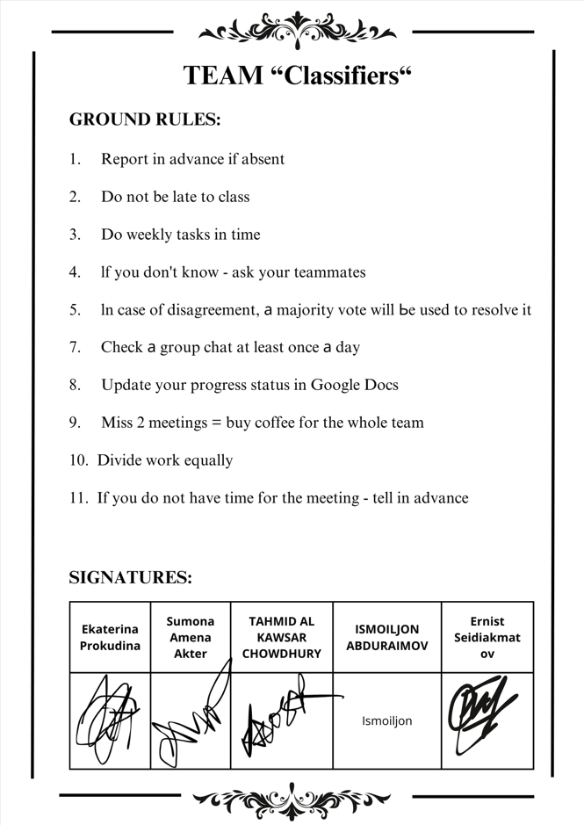
Team Ground Rule
Ground Rules: Basic rules that team members must follow autonomously
Think about your team activities and create ground rules that you must follow
Team Member Written-Signature

Slide 30
Project Proposal Presentation - Guideline
Project Proposal Presentation – Guideline
  Presentation time : 15 Minutes including Q&A
  Presentation slides : Max. 15 slides
Main Title | Contents
1. Cover Page | Course Name, Project Title, Team name and team member information, Division of roles within the team (Leader / Technical / Documentation, etc.)
2. Project Summary | Define project core issues, Summary of Hypothesis and Resolution Direction, Specify the distinction between technical and learning objectives
3. Background and Problem Description | Background of the problem, Limitations of existing systems or approaches, Interpreting the problem from the operating system perspective
4. Things to Investigate | Matters that require further investigation and verification, Factors of Technical Uncertainty, Areas that require experimentation or analysis
5. Project Constraints | Technical restraints, Time, environment, and tool constraints, Project scope limitations
6. Project Goals | Technical goals, Learning goals, Priorities and success criteria
7. Project Schedule | Step-by-step action plan, Interim inspection timing, Risk factors and response plan
8. References | Official documents, Teaching materials and reference manuals, Papers & technical data

Slide 31
Weekly Report - Use this form
Team Name (Week ?? – Month/Date)
Current Week Status | Next Week Plan
-Wrote LLD and made Software Architecture. . LLD completed (5/20 modules) – 4/13 . Made SW Architecture – 4/10 -Made datasets . Took pictures (200 pictures) – 4/13 - issue: take a long time to get enough pictures . Gathered dataset – 4/13 - list dataset here…….. -Implemented Graphical Interface . Coded (5/10 modules) – 4/10 | - Write LLD . Write LLD (20/20 modules) – 4/27 - Write code . UI (10 modules) – 5/20 . Feature Extraction(15 modules) – 5/10 . Classify Drug(10 modules) – 5/15 - Analyze Dataset . Dataset 1 – 4/23 . Dataset 2 – 4/25 - Get feedback from professor . LLD – 4/21 . Code – 4/21
Sample

Slide 32
It is prohibited to modify and distribute the contents of this material without permission.
All copyrights belong to ‘Life and Power Press - 생능출판사’.

